Slide 1
Radar and Navigational Aids (18ECE221T) . UNIT – 4. Radar Transmitter and Receiver . Sessions – 1, 2, 3.
Prepared by,
Dr. Diwakar R. Marur

Slide 2

Session - 1

Slide 3
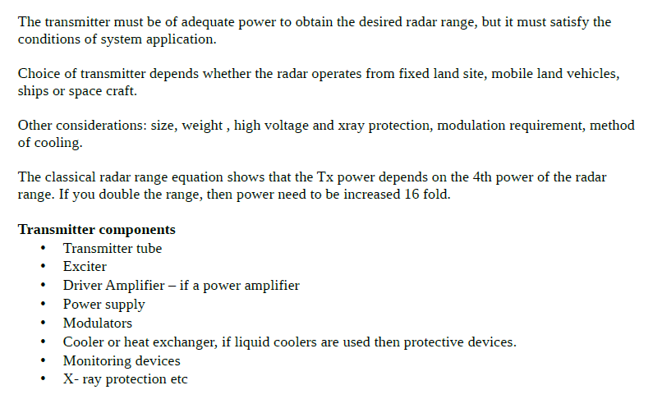

Slide 4
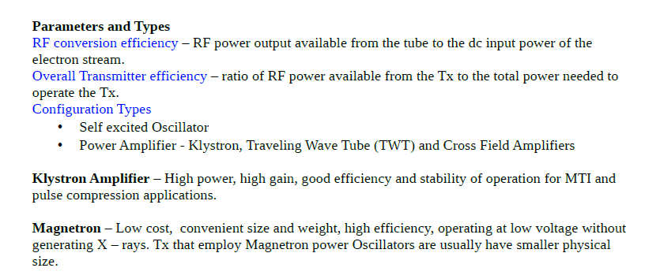

Slide 5


Slide 6
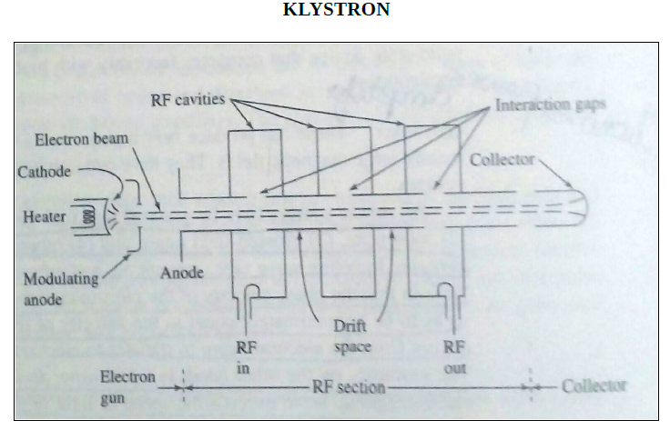

Slide 7
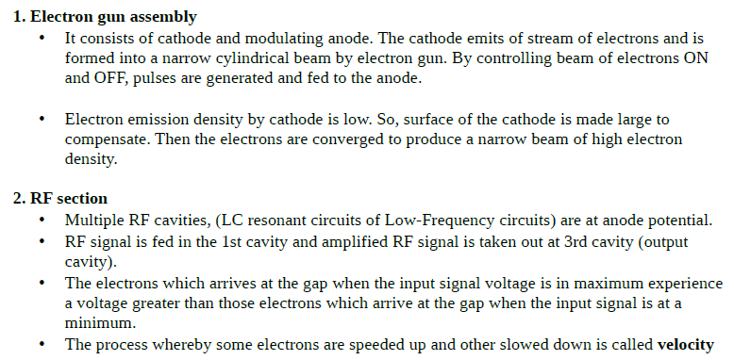


Slide 8


Slide 9

Session - 2

Slide 10
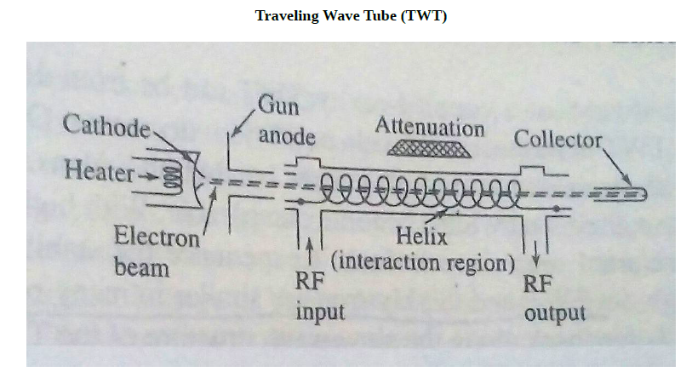

Slide 11
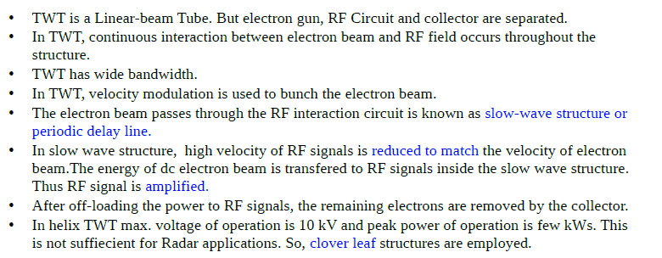

Slide 12
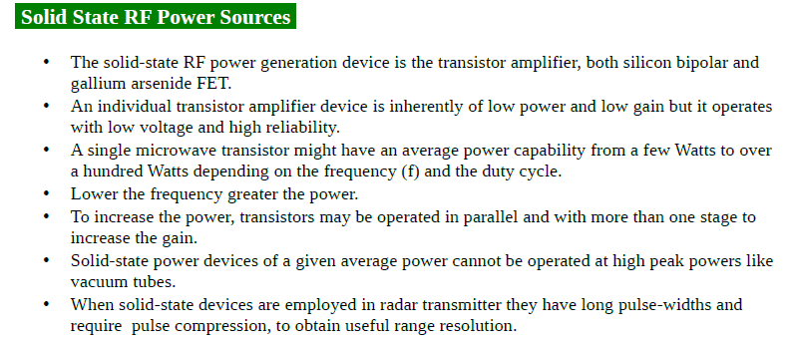

Slide 13
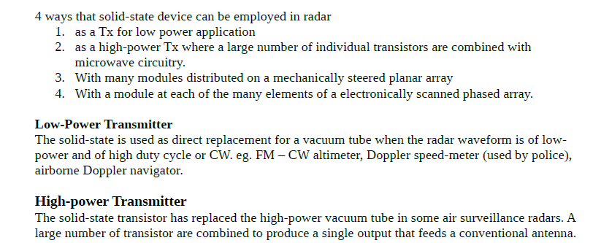

Slide 14
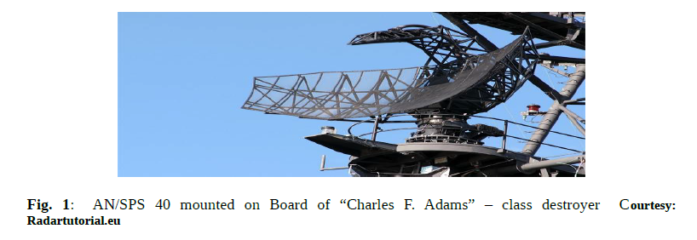

Slide 15
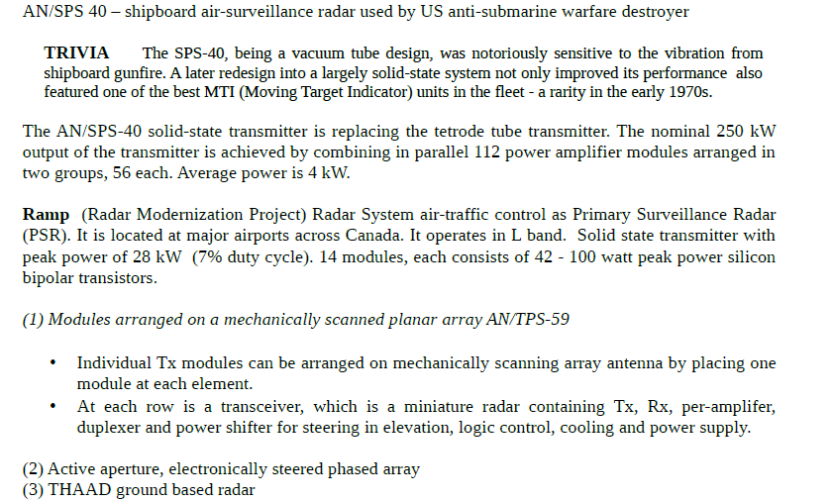

Slide 16
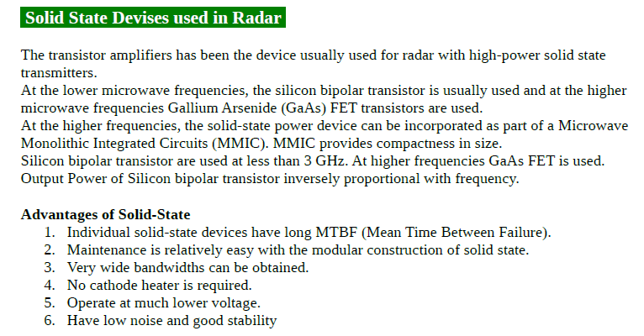

Slide 17

Session - 3

Slide 18
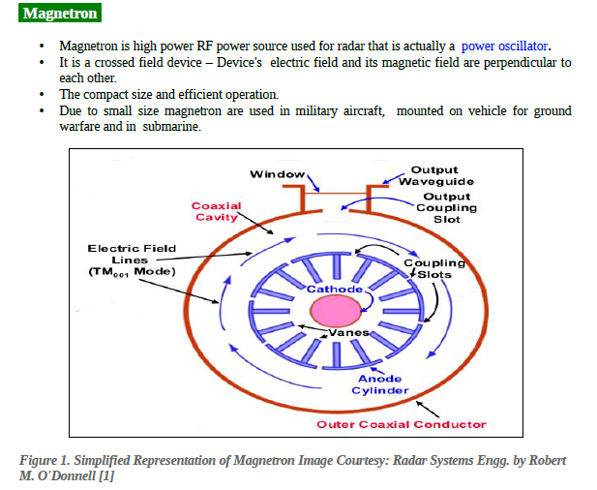

Slide 19
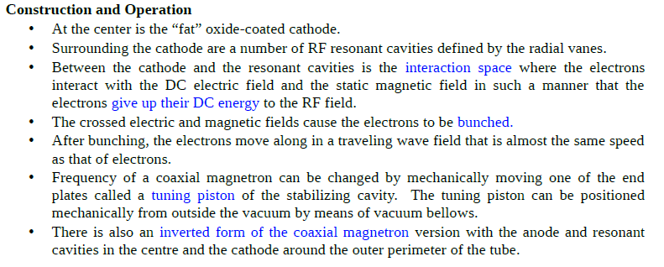

Slide 20
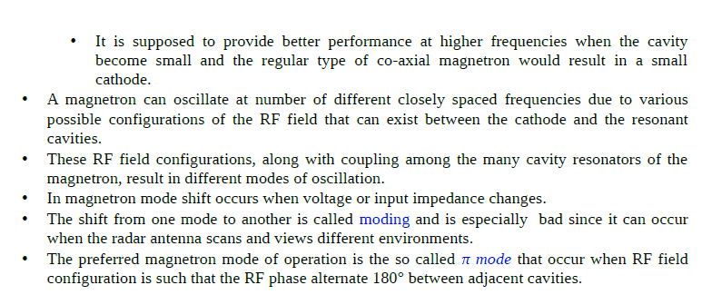

Slide 21
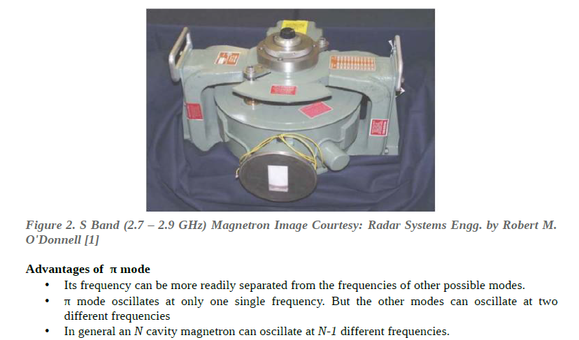

Slide 22

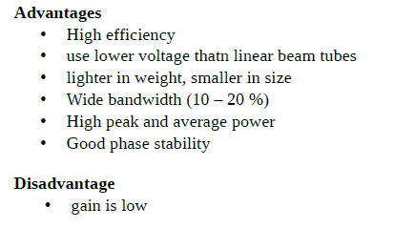

Slide 23
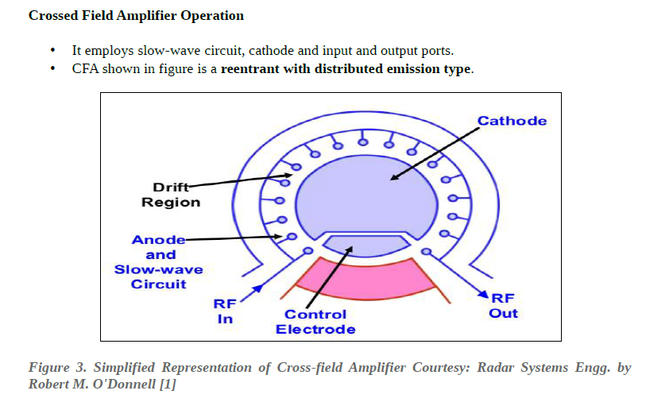

Slide 24
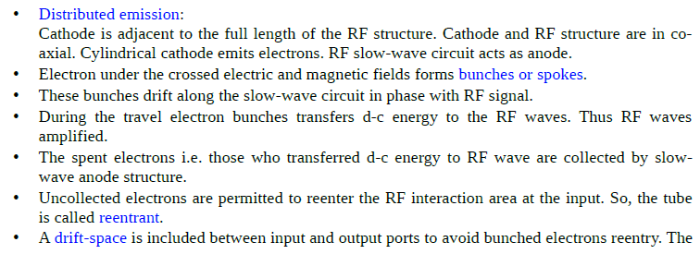


Slide 25
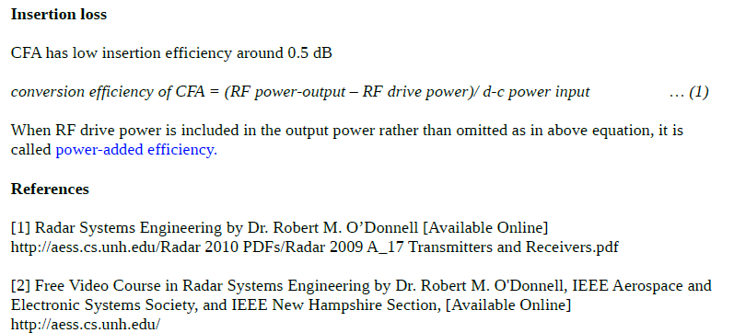

Slide 26
Text Book
Merrill I. Skolnik, “Introduction to Radar Systems”, 3rd Edition, Tata Mc Graw-Hill 2008.

Slide 27
Thank You

